Slide 1
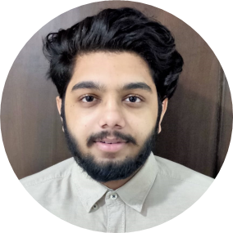

Potnuru Brijesh Sai Krishna
Analyst/Software Engineer
Bachelor of Technology
Electronics and Communication Engineering : 2018 - 2022
Skills
Core Java 11
Spring Boot
Spring MVC
Spring Core
Spring REST
Spring Security
ReactJS
Cloud Microservices
Full Stack
ReactJS
MongoDB
Database
No SQL database – MongoDB
Web Technologies
HTML5
CSS3
JavaScript
Add-Ons
GitHub
Maven
Postman
RabbitMQ
Additional Details
Peer Learning
Excellent Communication Skills
Team management
Bangalore
potnuru-brijesh-sai.krishna@capgemini.com
+91 7981622150
A4
Hands on Experience in Creating Microservices with Spring Boot, Spring Security, Spring Cloud API Gateway, Eureka Server, API Gateway.
Ready to learn new technologies and implement them to further improve my knowledge.
Eager to work in a team of dedicated people and serve a key role in the enhancement and development of the project.
Has working knowledge on ReactJS(Hooks)and Java Microservice Development using Spring framework on an intermediate level.
Worked on Spring Boot Application, JWT Authentication, Swagger UI and Eureka Server.
Online Flight Booking Application
Developed Online Flight Booking Application Using spring microservices and ReactJS with No-SQl as database Paytm as a payment in agile methodology of software development model.
HTML CSS JAVASCRIPT for web developers at Adapt Platform
Completed this course with 98.6% in HTML5 CSS3 Bootstrap and JavaScript.

